Slide 1



Forward Carers
Carers of People Living with Dementia Programme
January 2020

Slide 2
Dementia Programme -Background
Tender for Birmingham Carers HUB integrated carers provision (Feb 2019)
Birmingham City Council, CCGs and The Children’s Trust jointly commissioned Forward Carers from (July 2019)
New additions to Carers HUB provision to be phased during 2019-20
Provision included: Carer Passports; Health Liaison; Small Grants Administration; and Dementia Provision
Our Carers of People Living with Dementia Programme is informed by local Carer and Dementia Strategies; Carers Commitment; and carer need information

Slide 3
Dementia Programme - Background
The Birmingham Carer Commitments:
Recognise and respect the value of carers
Build a carer friendly city
Support carers to be physically and mentally well
Support young carers through childhood and education
Support carers to financially plan for today and tomorrow
Promote carer friendly employers
Informed by Birmingham Carers Vision and Commissioning Strategy 2018+
"create cohesiveness, building a network of provision for carers that is integrated"

Slide 4
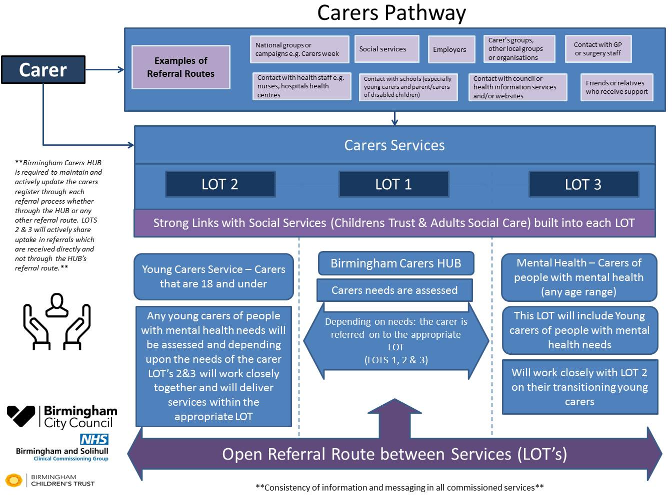

Slide 5
Dementia Programme – Strategy Refresh
What is dementia?
..A broad umbrella term that describes the progressive decline in someone’s mental ability. Symptoms include: memory loss, changes in behaviour and personality, problems with reasoning and communication skills, and a reduced ability to carry out daily activities, such as washing and dressing.
Strategy Priorities:
• Enabling access to a timely diagnosis and post-diagnostic support
• Information and services that focus on early intervention and prevention
• Preventing crises and supporting people with dementia within their communities
• Improving the quality of care, ensuring services are person-centred, integrated across health and social care and fit for purpose
• Improving advance care planning/end of life care.

Slide 6
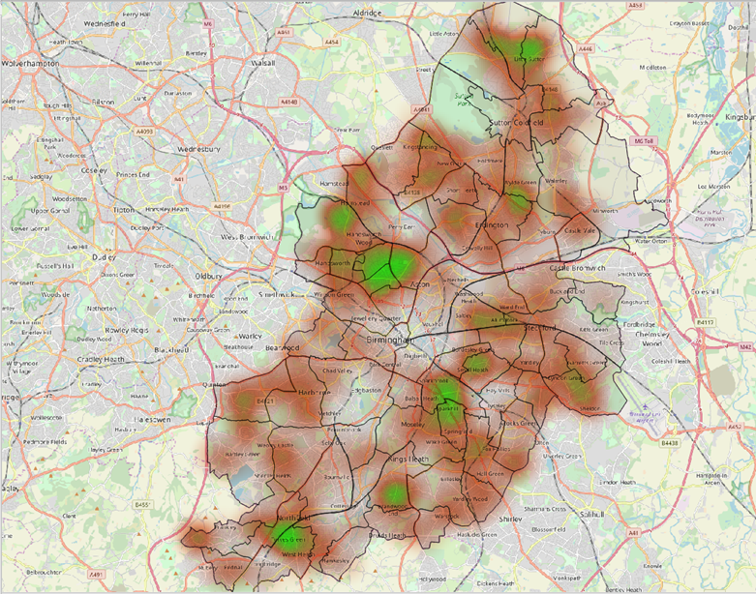
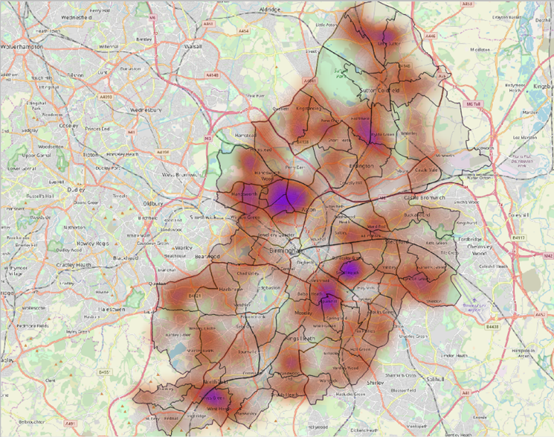
Forward Carers: Known Clients
Carer
Geo Heatmap
Cared For
Geo Heatmap

Slide 7
Forward Carers: Known Clients
Hours Caring
Unknown | 37 | 4.1%
0 - 9 Hours | 21 | 2.3%
10 - 49 Hours | 277 | 30.8%
50+ Hours | 565 | 62.8%
Carer Condition
No Recognised Condition | 545 | 60.6%
With Condition | 355 | 39.4%
With Dementia | 22 | 2.4%

Slide 8
Forward Carers: Known Clients
Carers Assessed | 269 |  | Carers Reviewed | 125
 |  |  | (Blanks Reviews) | 22
 | Assessment Score | Review Score | Change | % Change
Average Score | 2.98 | 3.23 | 0.25 | 8.2%
Your health and well being Score | 1.86 | 2.39 | 0.54 | 28.8%
Work, Education and Training Score | 2.92 | 2.97 | 0.05 | 1.8%
Your Financial Situation Score | 3.43 | 3.56 | 0.13 | 3.8%
Time Out Score | 1.92 | 2.28 | 0.36 | 18.6%
Other caring/family commitments Score | 3.36 | 3.63 | 0.28 | 8.3%
Relationships Score | 2.31 | 2.90 | 0.60 | 25.8%
Your Home Score | 3.33 | 3.20 | -0.13 | -3.9%
Your Diet Score | 3.55 | 3.88 | 0.32 | 9.1%
How Safe do you feel Score | 4.17 | 4.24 | 0.07 | 1.6%

Slide 9
Dementia Programme – new provision
Forward Carers intends to develop programme to Support Carers of People Living with Dementia, to be effective from April 2020. In order to fully implement this plan we intend to:
1) Enhance our Carers HUB Provision:
- Carer Assessments
- Emergency Back-Up and Planning
- Carers of adults living with dementia and a learning disability
- Online information and data collection
2) Commission the following services:
- Lot 1: Provision of Carer Support Groups - funding up to £100,000 pa
- Lot 2: Training for Carers – funding up to £25,000 pa
- Lot 3: Assistive Technology – funding up to £25,000 pa
Lo

Slide 10
Lot 1: Provision of Carers Support Groups
Key Outcomes:
Peer to peer support to share info and improves health and wellbeing
Effective channel for sharing info by facilitators or other services/professionals
A channel to deliver training to assist carers in their caring role
Find out about assistive technology and aids that could make a positive difference
A referral pathway into other support and health services
Promoted locally and via Birmingham Carers HUB, NNS, GPs / PCNs with Alignment with Adult Social Care and Health Dual Constituency Model, 5 groups as follows:
  Sutton and Erdington 2. Ladywood and Perry Barr
Hodge Hill and Yardley 4. Hall Green and Selly Oak
5. Northfield and Edgbaston

Slide 11
Lot 2: Training for Carers…
Key Outcomes:
• Carers have an increased awareness and understanding of dementia
• Carers can access practical guidance that assists people in living day-to-day with dementia (this should include understanding behaviours, managing personal care safely, infection awareness, reminisce)
• Carers better equipped to stay connected thus reducing the risk of social isolation
• Carers better informed about financial benefits and entitlements
• Carers able to plan with, and for the person they care for, now and in the future (this should include Power of Attorney and revoking a driving license)
Any training program will need to take into account the differing needs and situations of carers including working carers who may have limited availability to attend a regular training class during office hours.

Slide 12
Lot 3: Assistive Technology…
… We believe better use of technologies and equipment can make a real difference to people living with dementia and their carers
Key Outcomes:
People living with dementia maintain greater independence, stay active and safe community
Local carers are better informed about what’s available including through the NHS and Social Care but also what gadgets, equipment and technology can be purchased and where.
Carers have greater peace of mind and maintain a positive caring role
Assistive Technology includes equipment, devices and systems that maintain or improve a person’s ability manage day-to-day life safely. It is wide ranging and can be supportive in many ways including:
• Memory issues and managing tasks
• Communication, including speech and hearing
• Mobility
• Keeping safe at home and in the community
• Maintaining independence and self-confidence
• Keeping socially active.

Slide 13
Dementia Programme - Overview
Projects funded for 12 months with expectation of extension to March 2022
Successful projects will be Grant funded
Not-for-profits regardless of turnover
(see guidance notes: exception for Lot 3 if organisation has a strong social mission)
Projects to be focused on delivering outcomes to Birmingham carers
Expectation of match funding as part of the value for money assessment

Slide 14
Dementia Programme – Overview
There are 4 conditions to the grant:
Deliver the project as per described in the grant application;
Ensure that all Carers receiving a service are registered on the case management system (training will be provided);
At least 60% of Carers registered with the service must complete an initial and follow-up outcomes-based questionnaire, to be recorded on the case management system (training will be provided); and
Submit at least one case study via the case management system, every 6 months.

Slide 15
Dementia Programme - Overview
Applications close noon on Thursday 30th January 2020.
If applying for more than one Lot then a separate application will be required for each.
Organisations will be notified of the outcome of their application within three weeks of the closing date.
Service start date April 2020.

Slide 16
Carers Projects – Overview
You are strongly advised to read the Application Guidance and Clarification Question documents. These are available on the Forward Carers website.
Applicants should download the application form from the Forward Carers website and save to local computer/drive.
Please read all questions carefully and note where there is a word limit. Any text which exceeds the word limit will be discounted.
The first part of the form is information about your organisation/partnership.

Slide 17
Carers Projects – Completing your application
Question 11 – Please indicate which Lot you are applying for.
Question 12 – Tell us about your proposal. 500 words (scored 0 - 5)
(what are you going to do with the money and what difference is it going to make? Use later questions to give additional detail)
Question 13 – Where will your activities take place. City-wide or a specific local area?

Slide 18
Carers Projects – Completing your application
Question 14 – Please detail your prior experience of delivering specialist dementia services? 250 words (scored 0 – 5)
Question 15 – How does your proposal fit with existing activities? 250 words (scored 0-5)
Question 16 – How will you involve carers and communities in modelling and delivering? 200 words (scored 0 - 5)

Slide 19
Carers Projects – how to apply
Question 17 – What difference are you going to make? 200 words (scored 0 – 5)
Question 18 – How will you know if you have made a difference? 200 words(scored 0 - 5)
Question 19 – How will you implement your proposal? 200 words (scored 0 - 5)

Slide 20
Carers Projects – how to apply
Question 20 – How will you spend the grant? 200 words (scored 0 - 5)
(what are you going to spend the grant money on? What money of your own are you going to spend and are you going to charge carers for any of the services within this project?)
There is a list of things you can’t spend the grant on (see guidance) – but you can spend your own (match funding) money on those.
Total cost of project: | £30,000
Total grant applied for: | £20,000
Total of income to be raised from carers: | £500
Total of matched funding: | £9,500
Notes:
Projects which are purely about research
• Costs of ongoing staff who are not working directly on the project – including salaries of
permanent or fixed term staff
• Costs incurred in putting the application together
• Core costs of the organisation – (utility bills; rent; management costs etc.) which are not
directly related to the project activity
• Contingency costs e.g. funds to provide a source of income or for fundraising activities
• Political or religious activities
• Projects that take place outside of Birmingham.
• VAT that can be recovered
• Loans or interest payments.
• Purchase of alcohol or illegal substances

Slide 21
Carers Projects – Submitting your application
When you submit your application form, you will also need to upload:
A copy of your current constitution or terms of reference, set of rules or other governing document; and
Your latest annual accounts or a statement of income and expenditure. If your organisation has been running for less than two years you should send a 12-month financial projection for the year when you will spend the grant.
One set of accompanying information if you have applied for more than one Lot.
Applications cannot be processed without this information.
Notes:
Projects which are purely about research
• Costs of ongoing staff who are not working directly on the project – including salaries of
permanent or fixed term staff
• Costs incurred in putting the application together
• Core costs of the organisation – (utility bills; rent; management costs etc.) which are not
directly related to the project activity
• Contingency costs e.g. funds to provide a source of income or for fundraising activities
• Political or religious activities
• Projects that take place outside of Birmingham.
• VAT that can be recovered
• Loans or interest payments.
• Purchase of alcohol or illegal substances

Slide 22
Carers Projects – how will we evaluate?
The evaluation criteria – Initial Screening:
A completed application form – is it complete? Pass/Fail;
A copy of your current constitution or terms of reference – are you one of the organisations that is permitted to apply? Pass/Fail;
Your latest annual accounts or statement of income and expenditure has been submitted - Pass/Fail

Slide 23

Carers Projects – how will we evaluate?
The evaluation criteria – Stage 1:
A maximum of 2,000 words across 8 questions and 4 numbers (question 20) – you have to achieve a minimum score of 3 (satisfactory) for each of the 8 questions (24 points)

Slide 24
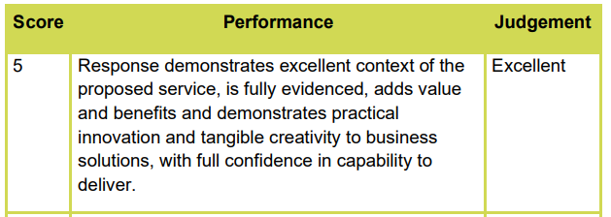
Carers Projects – how will we evaluate?
The evaluation criteria – Stage 1:
The Panel will need to understand what the project will do, evidence of need, that it will add value, that it’s different and the Panel is confident that it can be delivered for the money. Has the story been told concisely?

Slide 25
Carers Projects – how will we evaluate?
The evaluation criteria – Stage 1:
All applications remaining will be ranked in order based on the total score awarded
Forward Carers may decide to make an award after Stage 1, if the quality of the applications permits

Slide 26
Carers Projects – how will we evaluate?
The evaluation criteria – Stage 2:
Forward Carers reserves the right to select applicants to participate in Stage 2 of the application process, which will involve a Panel interview to ask some additional questions to gain further understanding about the proposal and its intended impact.

Slide 27
Carers Projects – Recap
Ensure all questions within the application form are completed.
You must upload a copy of your current constitution or terms of reference;
You must upload a copy of your latest annual accounts or a statement of income and expenditure;
If you have any questions please e-mail them to: info@forwardcarers.org.uk (please be aware that all points of clarification and enquiries will be shared on the Forward Carers website, to be fair to all applicants, although anonymity will be preserved)
Please note dates for stage 2 interviews (if required). These are detailed in the Application Guidance.

Slide 28
Thank you
Questions?

